Slide 1



MICROCONTROLLER BASED SYSTEM DESIGN
CSE 3215
Lecture 2

Slide 2
Types of Microcontroller
Microcontrollers are divided into categories according to their memory, architecture, bits and instruction sets.
Bits:
An 8-bit microcontroller works on 8-bits at a time. The examples of 8-bit microcontrollers are Intel 8031/8051, PIC1x and Motorola MC68HC11 families.
16-bits microcontroller executes with greater accuracy and performance in contrast to 8-bit. Example of 16-bit microcontroller is Intel 8096.
The 32-bit microcontroller uses the 32-bit instructions to perform the arithmetic and logic operations. These are used in automatically controlled devices including implantable medical devices, office machines, appliances and other types of embedded systems. Some examples are Atmel 251 family, PIC3x.

Slide 3
Types of Microcontroller
Memory
External Memory Microcontroller – When an embedded structure is built with a microcontroller which does not comprise of all the functioning blocks existing on a chip it is named as external memory microcontroller. For illustration- 8031 microcontroller does not have program memory on the chip.
Embedded Memory Microcontroller – When an embedded structure is built with a microcontroller which comprise of all the functioning blocks existing on a chip it is named as embedded memory microcontroller. For illustration- 8051 microcontroller has all program & data memory, counters & timers, interrupts, I/O ports and therefore its embedded memory microcontroller.

Slide 4
Types of Microcontroller
Instruction Set
RISC- RISC means Reduced Instruction Set Computers. It is a CPU design strategy based on simple instructions and fast performance. RISC reduces the operation time by shortening the clock cycle per instruction.
CISC- CISC means Complex Instruction Set Computers. It is a CPU design strategy based on single instructions, which are capable of performing multi-step operations. CISC computers have shorted programs. It has a large number of complex instructions, which takes long time to execute. Most instructions are completed in two to ten machine cycles.

Slide 5
Types of Microcontroller
RISC | CISC
The RISC processors have a smaller set of instructions with few addressing modes | The CISC processors have a larger set of instructions with many addressing modes.
Emphasis on software | Emphasis on hardware
Instruction sizes are same | Multiple instruction sizes and formats
Use more registers | Use Less registers
Instructions take one cycle time | Instructions take a varying amount of cycle time
Pipelining is easy | Pipelining is difficult

Slide 6
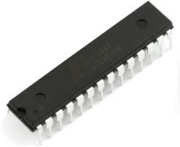
Types of Microcontroller
Packaging
Dual In-line Packages (DIP)
This is one of the oldest and most widely adopted packaging.
These packages may be directly inserted through the holes of the printed circuit board (PCB) or it may be placed over an inexpensive socket. Through-hole packages are generally bigger, and much easier to work with. They’re designed to be stuck through one side of a board and soldered to the other side.
A DIP is usually referred to as a DIPn, where n is the total number of pins. For example, a microcircuit
package with two rows of seven vertical leads would be a DIP14.

Slide 7
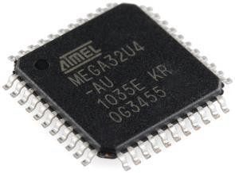
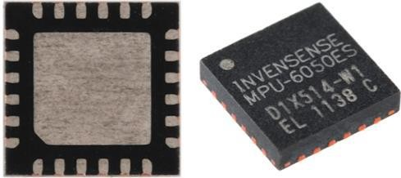
Types of Microcontroller
Surface-Mount Packages (SMP)
Surface-mount technology (SMT) is a method for producing electronic circuits in which the
components are mounted or placed directly onto the surface of printed circuit boards (PCBs).
An electronic device so made is called a surface-mount device (SMD).
By employing SMT, the production process speeds up, but the risk of defects also increase due to component miniaturization and to the denser packing of boards

Slide 8
Types of Microcontroller
Memory Architecture
Von Neumann Architecture
The Von Neumann Architecture, which is also known as Princeton Architecture describes a design architecture for an electronic digital computer with parts consisting of a
processing unit containing
an arithmetic logic unit and processor registers;
a control unit containing
an instruction register and program counter; a memory to store both data and instructions; external mass storage; and
input and output mechanisms.

Slide 9
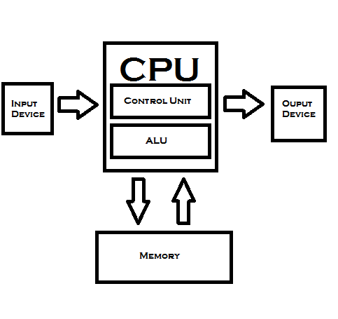
Types of Microcontroller
Microcontrollers based on the Von-Neumann architecture have a “single data bus” that is used to fetch both instructions and data. Program instruction and data are stored in a common main memory.
When such a controller addresses main memory, it first fetches an instructions, and then it fetches the data to support the instruction. The two separate fetches slows up the controller’s operation.

Slide 10
Types of Microcontroller
Harvard Memory Architecture
The Harvard architecture is a computer architecture with physically separate storage and signal pathways for instructions and data.
The term originated from the Harvard Mark I computer, which stored instructions on punched tape(24 bits wide) and data in electro-mechanical counters.
In a Harvard architecture, there is no need to make the two memories share characteristics. In particular, the word width, timing, implementation technology, and memory address structure can differ.

Slide 11
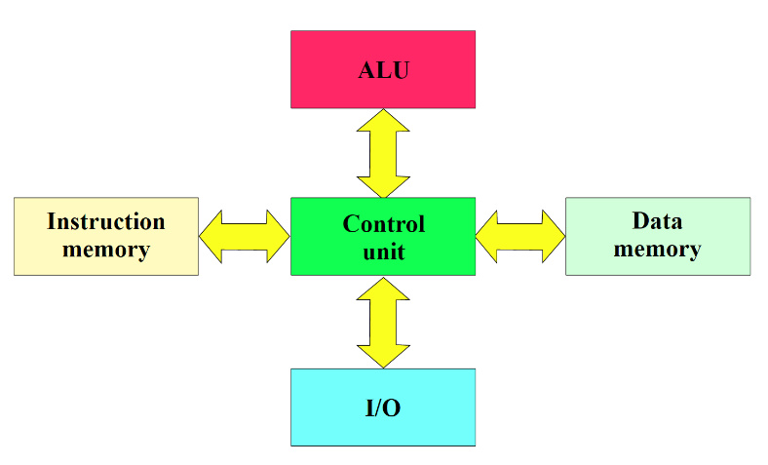
Types of Microcontroller
In some systems, instructions for pre- programmed tasks can be stored in read- only memory while data memory generally requires read-write memory.
In some systems, there is much more instruction memory than data memory so instruction addresses are wider than data addresses.

Slide 12
Types of Microcontroller
Modified Harvard architecture
Modern high performance CPU chip designs incorporate aspects of both Harvard and von Neumann architecture.
In particular, the "split cache" version of the modified Harvard architecture is very common.
CPU cache memory is divided into an instruction cache and a data cache. Harvard architecture is
used as the CPU accesses the cache.
In the case of a cache miss, however, the data is retrieved from the main memory, which is not formally divided into separate instruction and data sections, although it may well have separate memory controllers used for concurrent access to RAM, ROM and flash memory.
Thus, while a von Neumann architecture is visible in some contexts, such as when data and code come through the same memory controller, the hardware implementation gains the efficiencies of the Harvard architecture for cache accesses and at least some main memory accesses.

Slide 13
Types of Microcontroller
Harvard Architecture | Von-Neumann Architecture
It has separate data and program memory. | It has common data and program memory.
More hardware or separate data and address bus for each memory. | Requires less hardware as requires only one data and address bus.
Requires more space. | Requires less space.
Control unit for two Buses is more complicated. | One bus is simpler for the Control Unit design.
Production of a computer with two Buses is more expensive. | Computer with one bus is cheaper.

Slide 14
Types of Microcontroller
Harvard Architecture | Von-Neumann Architecture
Development of a complicated Control Unit needs more time. | Development of a simple Control Unit needs less time.
Processor can fetch data and instructions simultaneously. | Only either data or instructions can be fetched at a time.
Speed of execution is fast. | Speed of execution is slow.
Empty space in program memory cannot be used for data & vice versa. | Memory size for data and instructions can be adjusted or interchanged.

Slide 15
Examples of some popular microcontrollers
Features | 8051 | DS89C420/30 | Atmega 32 | PIC 168 FX | Motorola 68HC05
ROM | 4 K | 16 K | 4 K | 512 B | 256 B
RAM | 128 B | 256 B | 128 B | 2 K | 176 B
Timers | 2 | 3 | 2 | 1 | 1
I/O pins | 32 | 32 | 32 | 13 | 24
Serial Port | 1 | 1 | 1 | 0 | 1
Interrupt | 6 | 6 | 6 | 1 | 0

Slide 16
List of some Microcontroller Manufacturers
Atmel
Dallas Semiconductor
Freescale Semiconductor
Intel
Microchip
National Semiconductor
Renesas
STMicro
Texas Instruments
Zilog

Slide 17
THANK YOU

